Slide 1
Educational Measurement and Item Development
An Introductory Workshop
Dr Nathanael Reinertsen
Directorate for Education and Skills
25 October 2024

Slide 2
Workshop Overview
Day 1
What is educational measurement?
Day 2
Item Development Principles
Day 3
Item evaluation (with Rasch Measurement, and Item-Response Theory)
Day 4
Test construction and test evaluation
Day 5
Cognitive Walkthroughs in Item Development

Slide 3
Day 5 Outline
Cognitive Walkthroughs in Item Development
Session 1
Practical part 2: Cognitive Walkthroughs
Session 2
Practical part 2: Cognitive Walkthroughs
Session 3/4
Workshop summary, final questions, lessons learned, and closing.

Slide 4
3
Practical part 2: Cognitive Walkthroughs

Slide 5
Discussion procedure
Review of stimulus
Review of first item
Review of second item
Review of third item
Final remarks

Slide 6
Sharing session
Pick one to share about your group’s Cognitive Walkthrough:
What made the discussion good/enjoyable?
What was one difficult thing about the exercise?
Is it a process you could see implementing?

Slide 7
4
Summary

Slide 8
Workshop Recap
What is educational measurement?
Measurement concepts
Assessment Frameworks
Validity
Item Development Principles
MC and CR items
CTT
Reliability
Item evaluation
Rasch Measurement
Assessment Principles and Methods
Rubric Construction
Test construction and test evaluation
Item banks and Test Construction
Test equating
Cognitive Walkthroughs in Item Development
The role and process of collaborative review in item development

Slide 9
Workshop aims
Workshop participants should gain…
1
Knowledge of educational measurement theory
2
Deeper understanding of PISA-style, large-scale assessments
3
Enhanced item and test development skills
4
Increased assessment literacy

Slide 10
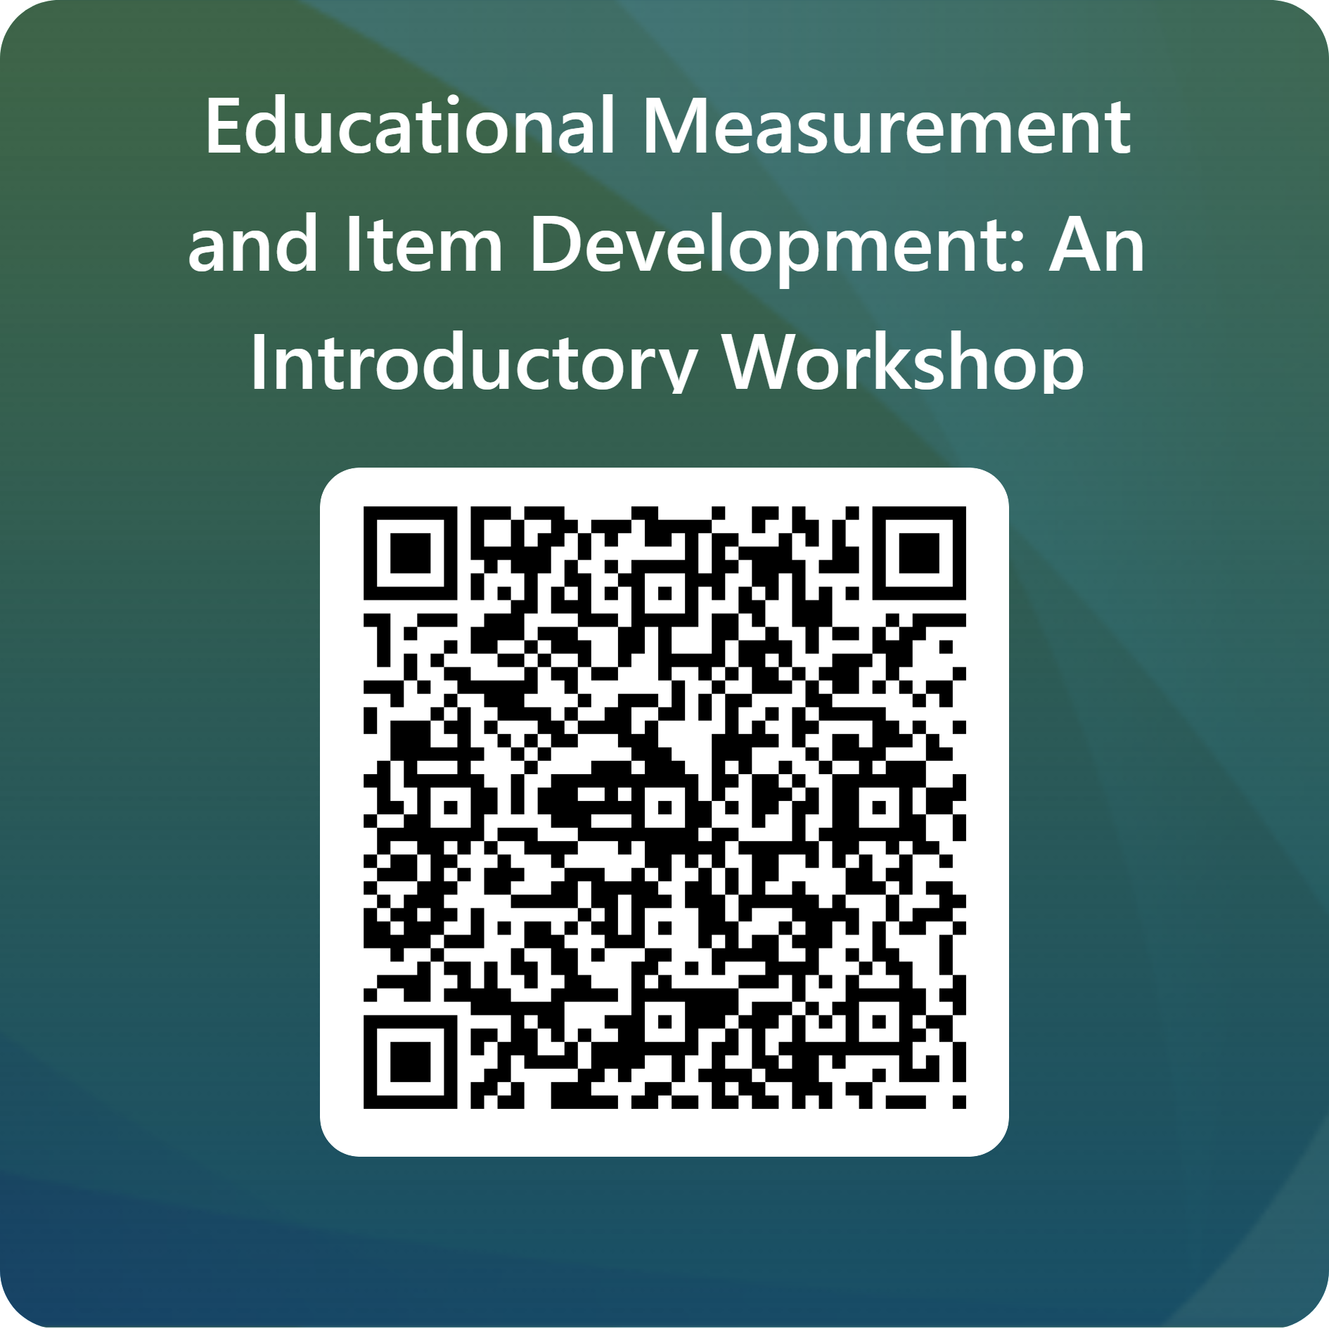
Feedback, please!!!

Slide 11
Thank you

